Slide 1
Västtrafik – Mobility for a sustainable future
Roger Vahnberg, Senior Vice President Västtrafik AB 2021-12-09
Notes:
My name is Roger Vahnberg and I am Senior Vice President and deputy CEO at Västtrafik. I also active member of UITP and have been a member of UITP Policy Board since 2011 and Executive Board since 2015. Presently chairing UITP Presidents Committee, PresCom.

Slide 2
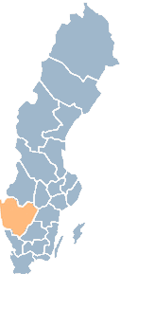
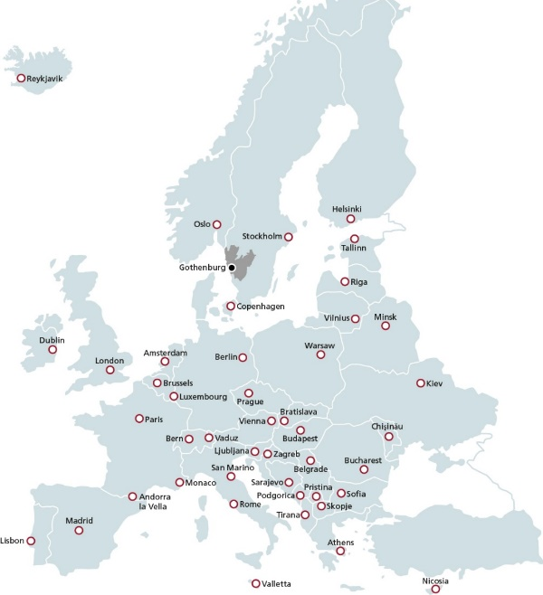
The Region Västra Götaland
1.7 million inhabitants (17% of Sweden´s population)
49 municipalities
300 kms long and 250 kms wide
The largest city is Gothenburg
The region has the largest port in Scandinavia
Notes:
First briefly about our region Västra Götaland.
It’s located in the western part of Sweden and has 1,7 million inhabitants, which is 17% of Swedens population.
The area consists of 49 municipalities
The largest city is Gothenburg, with 580 000 inhabitants
Gothenburg is also is the second largest city in Sweden

Slide 3
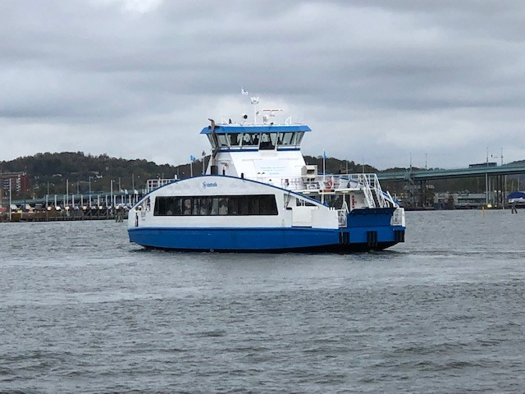
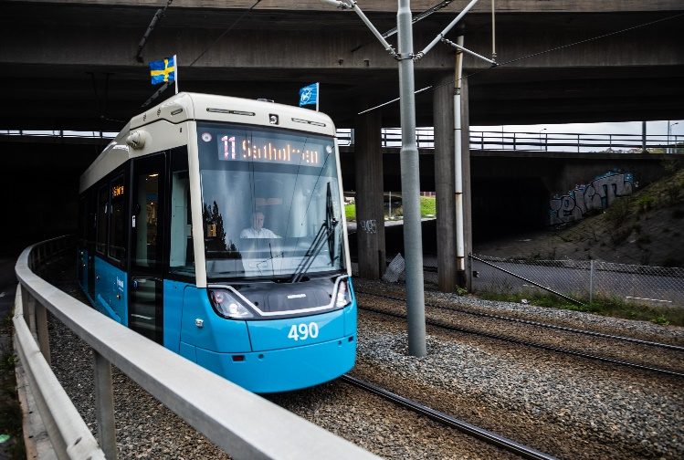
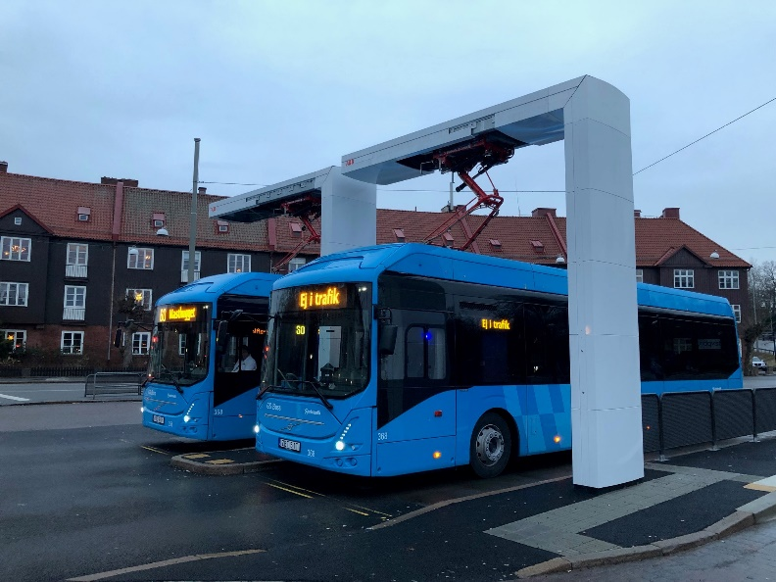
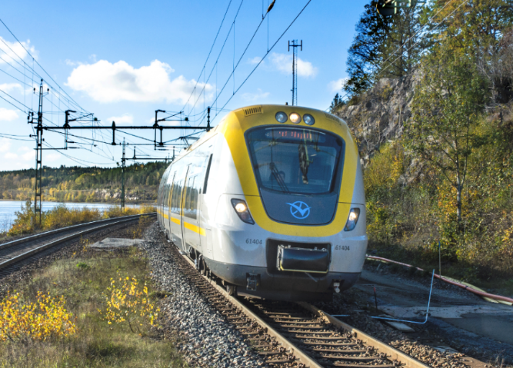
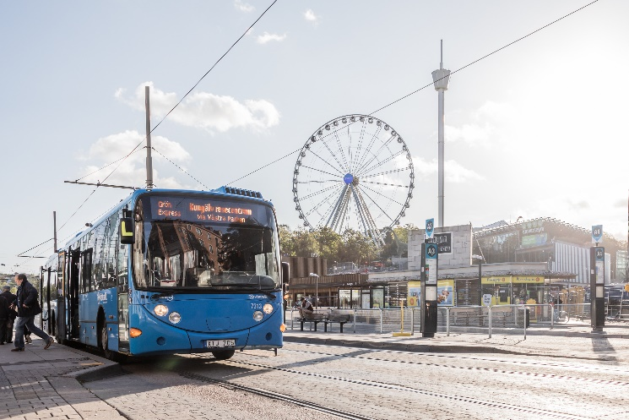
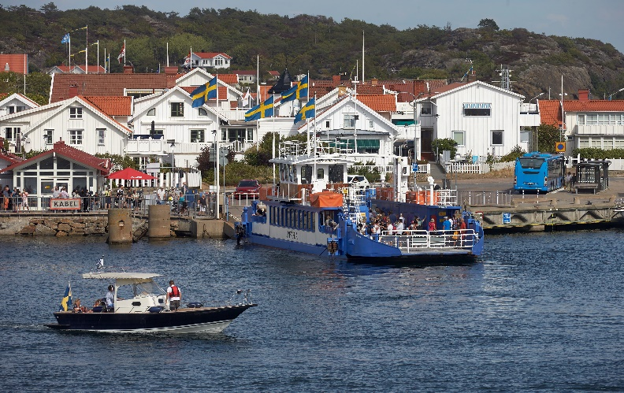
Västtrafik, pre pandemic 355 million trips per year
Notes:
Västtrafik is a public transport authority of west Sweden, owned by the Region of Västra Götaland.
We are responsible for all public transport in our region. That means buses, trains, trams, and ferries.
We tender all traffic services.
Normally a contract is 10 years long. The buses are owned by the operators.
We specify the buses following a Nordic standard and the buses are allowed to be maximum 10-13 years old depending on the type of traffic.
At Västtrafik we are 400 employees and
including our tendered partners,
we are about 9000 people making the public transport in our area.
We have 80 tendered partners.
Before pandemic we had 355 million trips per year, and we were ahead of schedule to reach our goal of doubling the ridership to 2025
Then Mars 2020 came and with the pandemic it fell 50%.

Slide 4

Notes:
PT is the backbone in sustianable travel. It is together with other sustaianble modes we can reach the vision.

Slide 5

Notes:
This is the 17 sustainable development goals, which all of you already probably are familiar with.
Public Transport contributes to almost all of them and they are the blueprint to achieve a better and more sustainable future for all.
Goal number 11, Sustainable cities and communities, pinpoints the public transport as a tool,
And goal 13 highlight climate actions
The Public Transport is indeed very important in creating a sustainable and livable city, with a good air quality and good environment.
All our operators must follow a code of conduct that is the same for all regions in Sweden. That means for example that the operators must secure that the production of buses have Sustainable supply chains. That Human rights are not violated. The PTA for the three large regions in Sweden are working together to develop the contract requirements as well as how we follow up these requirements. We also work together with our operators to step by step become better in this. It is complicated but for us it´s important that we are sustainable in all ways which of coarse means both ecological as well as social.

Slide 6
CO2 reduction 2006-2035 (CO2/pkm)
98 % renewable energy in bus traffic
Notes:
Västtrafik has high climate goals. In Sweden we have a national goal to reduce CO2 by 70% to 2030. Västtrafik has already achieved that. Our goal is to reduce CO2 emissions by 90 Percent before 2035.
Basically, all our bus traffic run on renewable energy, to reach our climate goals, electrification on a large scale is needed
Electrification is preferable in city traffic, since electric buses are silent and emission free, which benefits the development of the city environment. Our regional traffic will primarily use biogas. We plan to have all city traffic electrified at the latest 2030, but most will be electrified by 2025 due to when different traffic is procured.

Slide 7
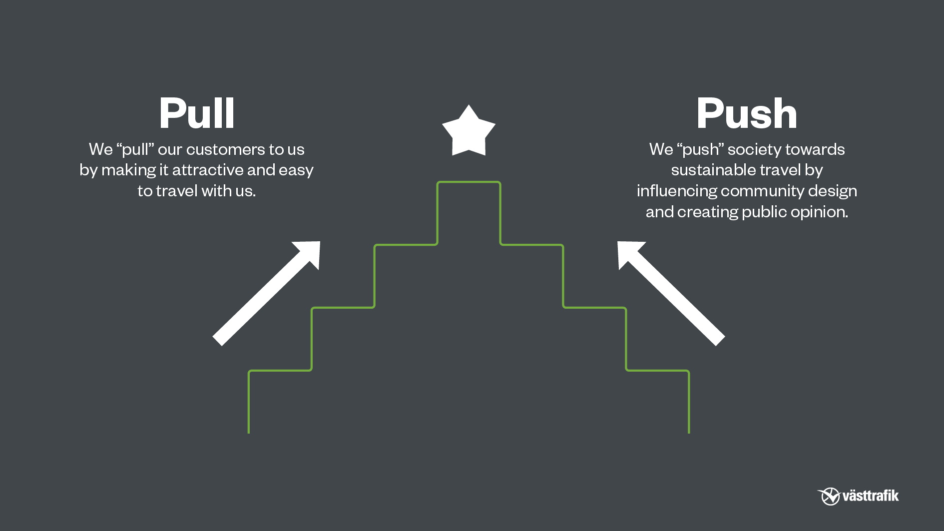
Notes:
Pull: An App where most tickets are sold, three zones instead of 70,
Combine journeys: Test with Gothenburg parking company,
Train tunnel under Gothenburg with three underground stations makes it easier to travel from the region. Easy to take a bike from the station for the last mile.
Push: Close cooperation with other actors is essential to succeed.

Slide 8
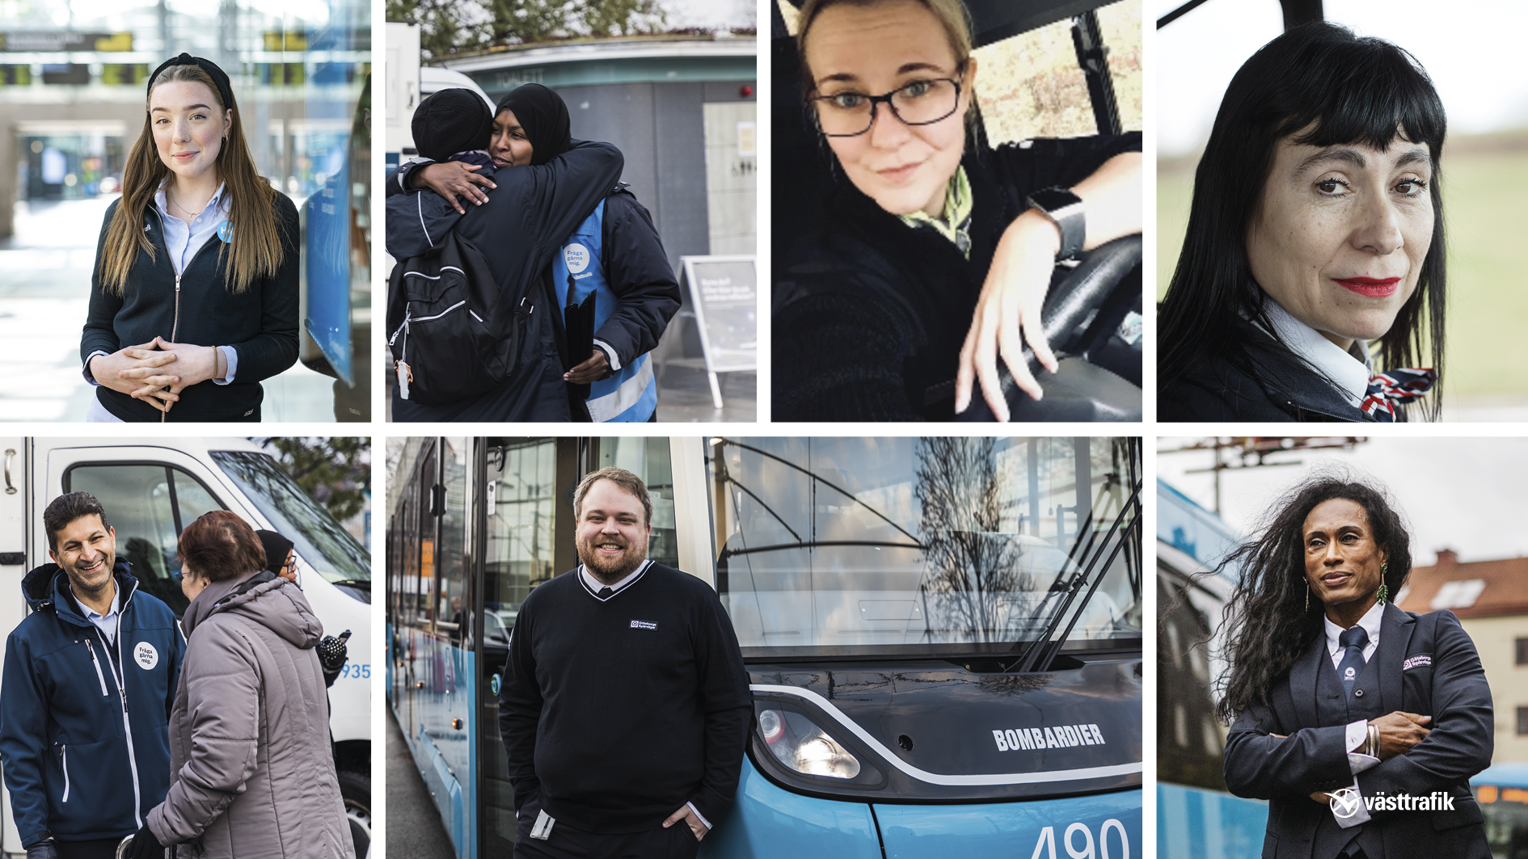
Notes:
For us it is important that we have a partnership with our operators. It is together that we can reach our very high goals.
We tender everything. Normally 10 years contract. Of 80 partners a couple are owned by municipalities but all others are different private companies in very different sizes.
The buses are owned by the operators but have to meet certain specifications like maximum age 10 – 13 years depending of type of traffic. Trains, trams and some ferries are owned by Västtrafik.
Together with our partners we are 9000 employees who work for Västtrafik.

Slide 9
Thank You!
Contact: roger.vahnberg@vasttrafik.se
Notes:
All major trends are the same as before the pandemic, we still have the climate change, we still have urbanisation. All our long-term goals remain. Our investments in electric buses, electric ferries, trams, and trains continues. We probably have a little lower ridership compared to pre pandemic when we have got our customers back due to shifting behaviour and working from home. But from there we must, and we will, increase the ridership with public transport as well as walking and biking. This is necessary to get an attractive and sustainable city and region.
Thank you very much for listening

