Slide 1
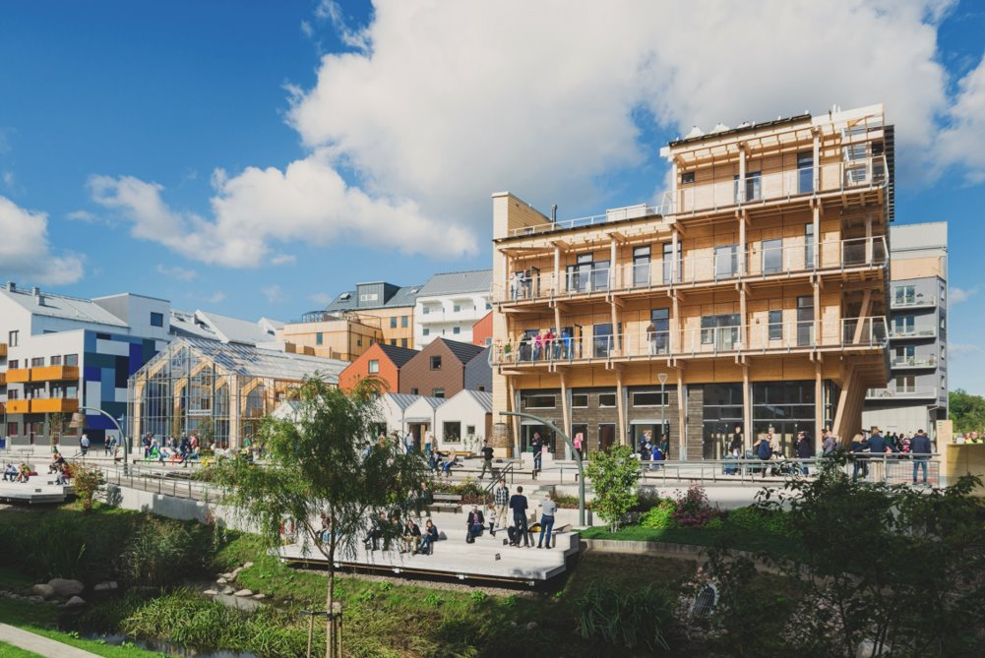


EXPLORE SMART & SUSTAINABLE SOLUTIONS FROM SWEDEN
Östen Ekengren
Osten.Ekengren@ivl.se
​@smartcitysweden ​
smartcitysweden.com
Notes:
Smart City Sweden is a state-funded initiative for smart and sustainable city solutions from Sweden. We welcome delegations from all over the world who are interested in investing in Swedish solutions. On our website, we showcase best practice within smart and sustainable city solutions from Sweden, as well as companies who are ready to export the solutions.

Slide 2
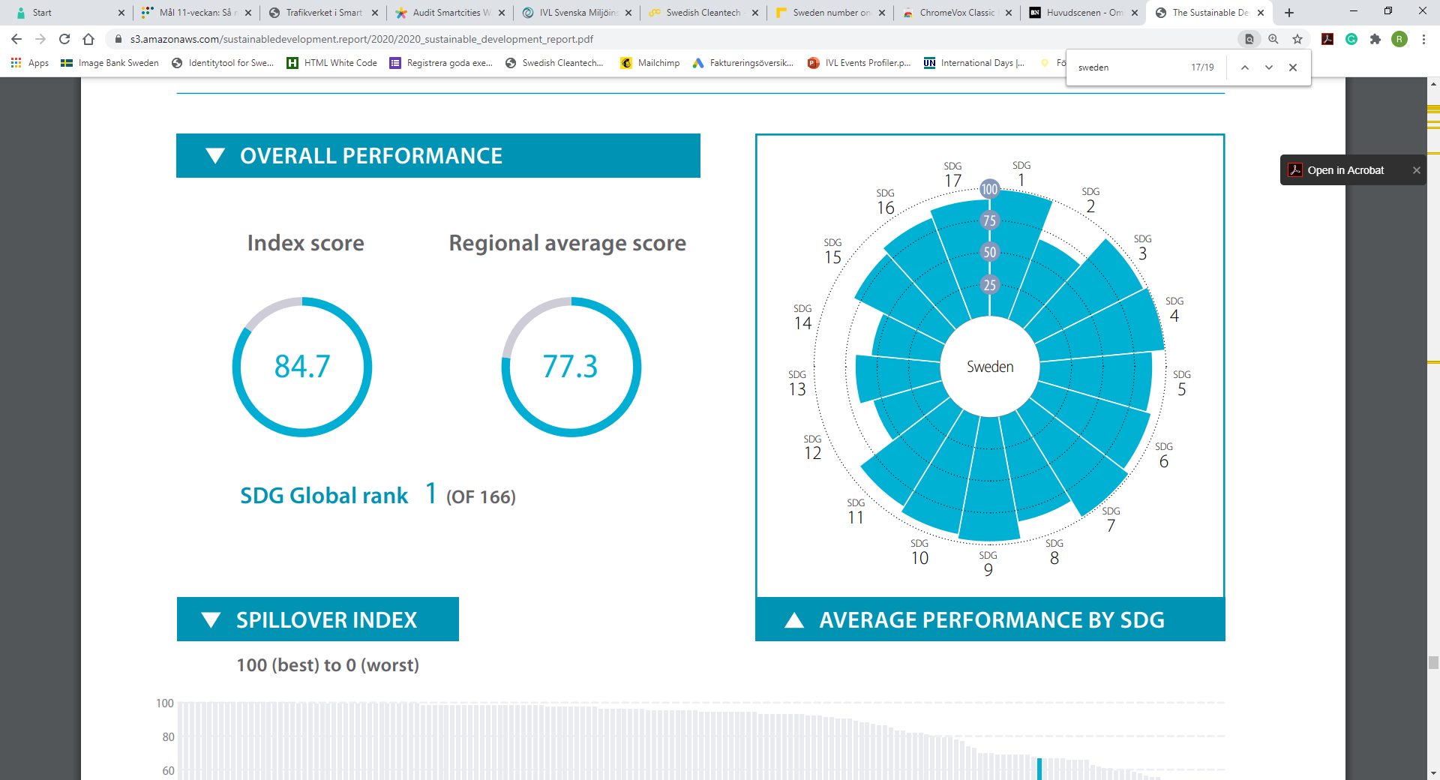
SUSTAINABLE DEVELOPMENT REPORT 2020​
SDG Global rank: 1 (of 162)​
Index score: 84,82​
Regional average score: 77.3
Notes:
In the latest Sustainable Development Report, Sweden was ranked nr 1 in reaching the Global Goals out of 162 countries. Sweden ranked high in goals such as good health and well-being (3), gender equality (5) and affordable and clean energy (7), but still face challenges reaching goals such as Sustainable consumption (12) and life below water (14).

Slide 3
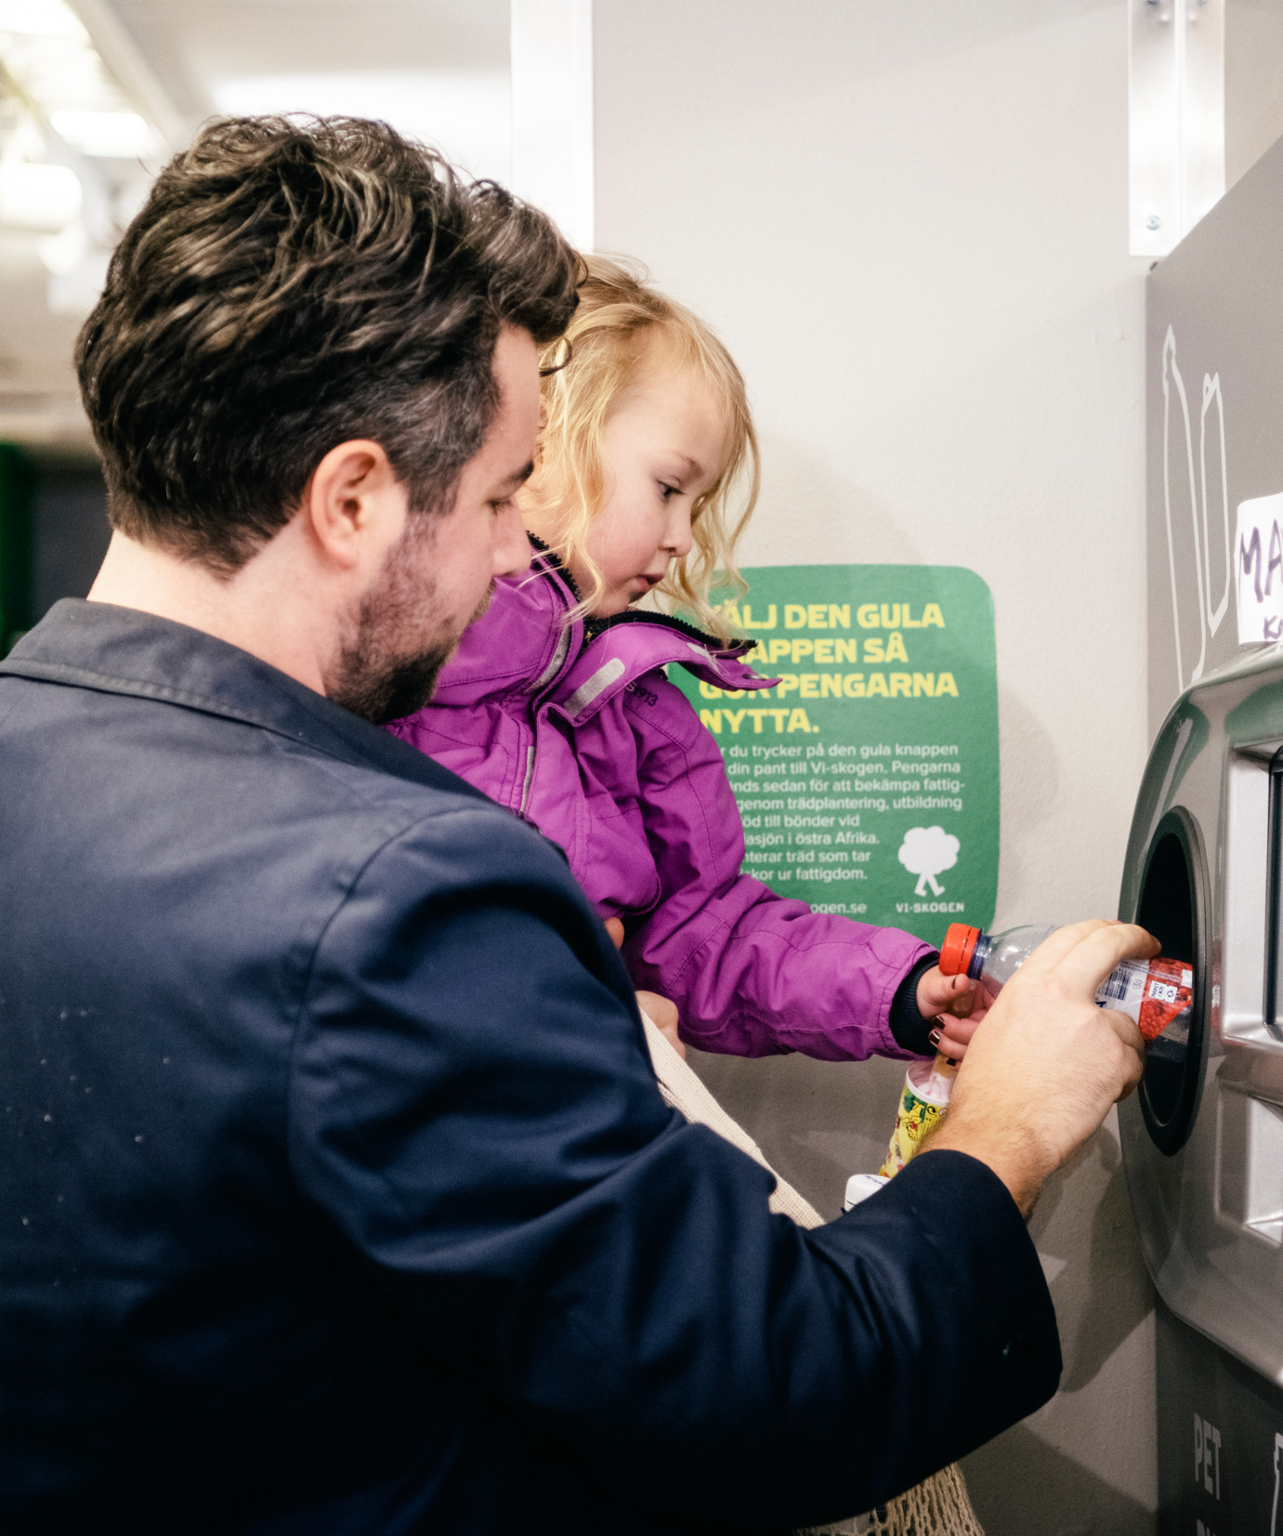
…but how did we get here?
Innovations
Citizen engagement​
System solutions ​
Eco Governance
Notes:
Sweden is well-known for our many innovations – both products and business ideas ​
We have a long history of educating our citizens and involving citizens in the process – one example is waste management, where citizens play a big part in sorting and collecting the waste
​
Eco Governance – common holistic goal for city planning . Sweden has for a long time worked with finding ways to cooperate between the private and the public sector, which has allowed us to establish long-lasting and sustainable system solutions for our cities, with win-win situations for both the tax payers and the companies involved ​
​

Slide 4
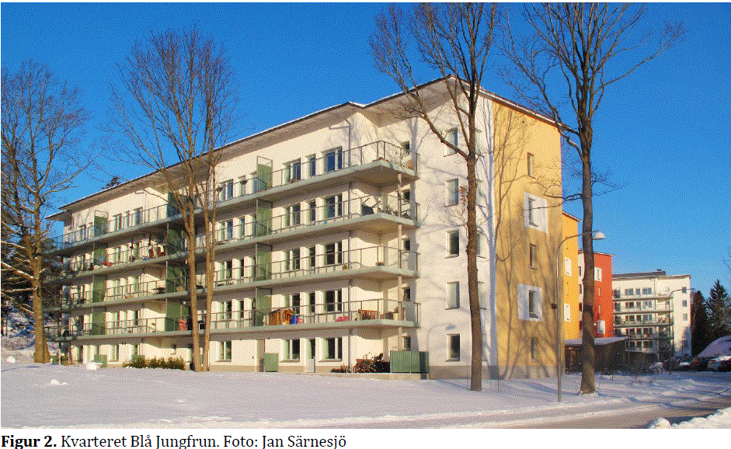
Transformative changes needed

Slide 5
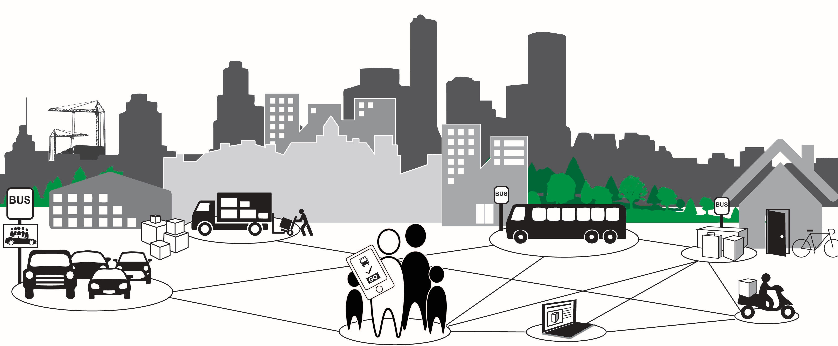

Mobility
Three revolutions:
EV cars and alternative fuels
Autonomous vehicles
Sharing
Notes:
Vi tror också att det kommer att behövas ändrade beteenden.
Inom transporter pratar man om tre revolutioner: eldrift, självkörande bilar och delning. De två första revolutionerna räcker inte för att få ett hållbart transportsystem.
En möjlig utveckling är att vi går från att äga bilar som för det mesta inte används till att beställa en transport när vi behöver den. Det skulle kunna minska antalet bilar kan minska med 60-85%. Men kommer människor att acceptera detta?

Slide 6
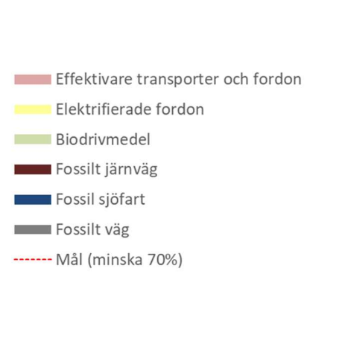
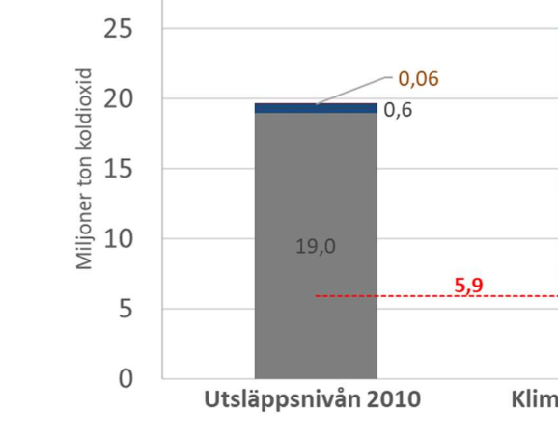
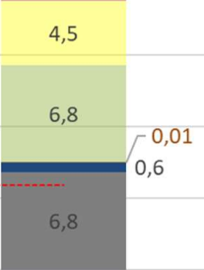


biofuels + efficiency + electrification
all tools are necessary for decarbonisation of transport
WWF and IVL scenario for reaching the Swedish 2030 goal for decarbonisation of transport
6,2
More efficient transport & vehicles
Electrification
Biofuels
Fossil – railway
Fossil – maritime
Fossil – road
Goal – 70% decrease
Million tonnes CO₂
2030
scenario
2010
emission level
Det här fotot av Okänd författare licensieras enligt CC BY-SA
Notes:
Ref: Transportstudien 2019, Analys av åtgärder för en hållbar transportsektor, IVL (Swedish Environmental Research Institute) & WWF
Report Nr C 450
Figur 5. Illustration av utgångsläget 2010, effekten av klimatscenariots inledande steg och kvarvarande
behov av utsläppsminskning. Vänsterstapeln visar klimatpåverkan från inrikes transporter år 2010,
ungefär 19,6 miljon ton. Högerstapeln visar utsläppsnivån år 2030. Stapelns höjd motsvarar utsläppsnivån
är 2030 enligt referensscenariot om inga åtgärder alls skulle ha genomförts. Färgade ytor visar effekter av
de åtgärder som beräknats i klimatscenariots steg med ökad elektrifiering, effektivare transporter och
fordon samt ökad användning av biodrivmedel. De kvarstående fossila utsläppen är 7,3 miljoner ton. För
att nå målet om 70 procents reduktion behöver utsläppen minska ytterligare för att komma ner till 5,9
miljon ton som illustreras av den röda linjen.

Slide 7
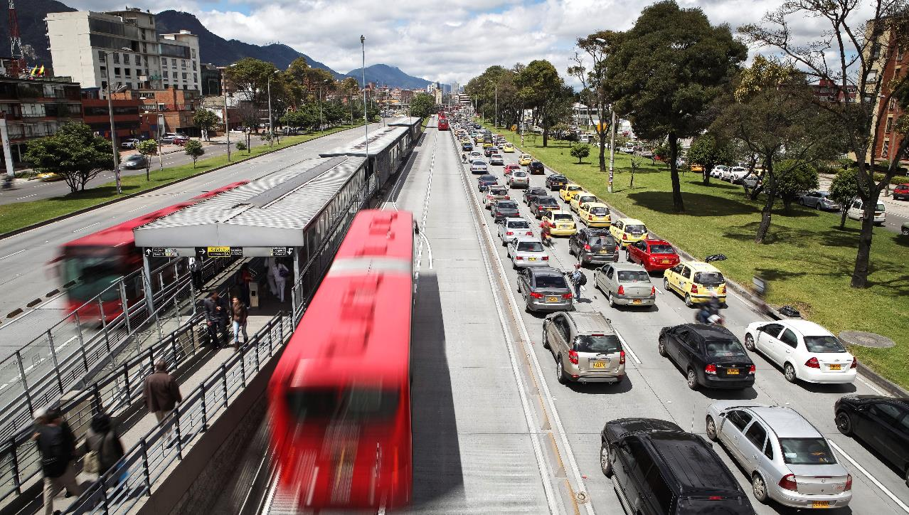


Bus systems by Scania (BRT) an attractive and cost efficient solution for growing cities
Smart and safe transport
Petrol car
Diesel bus
Sustainable fuel BRT bus
Notes:
Public transport is a a smart way to make your city cleaner, less congested and more attractive.
Often, unfortunately, when a bus is bought, it is placed here (point at traffic jam). It should of course be here – in a dedicated lane. Nobody would think of placing a train outside the track, right?
CLICK
Applying the same thinking as for a rail system, only using buses, you will get a Bus System (or a BRT, Bus Rapid Transit).
There are many advantages with a bus system – here you see an example from Bogota, where more people travel in the system, than in some of the biggest metro systems.
It can be implemented quickly, in less than 2 years, whereas a rail solution often takes more than 10 years.
It is also much more flexible than a railbound system, and it can grow with the city.
The high frequency also makes it easy and attractive for the passenger.
Basically, you get all the benefits of a rail system, and more, but to a fraction of the cost, often 10% of a rail system!
CLICK
When shifting people from the car to public transport, we get a dramatic cut in emissions. Then, if we power the vehicles with clean, low carbon fuels, we really have a sustainable transport system.

Slide 8
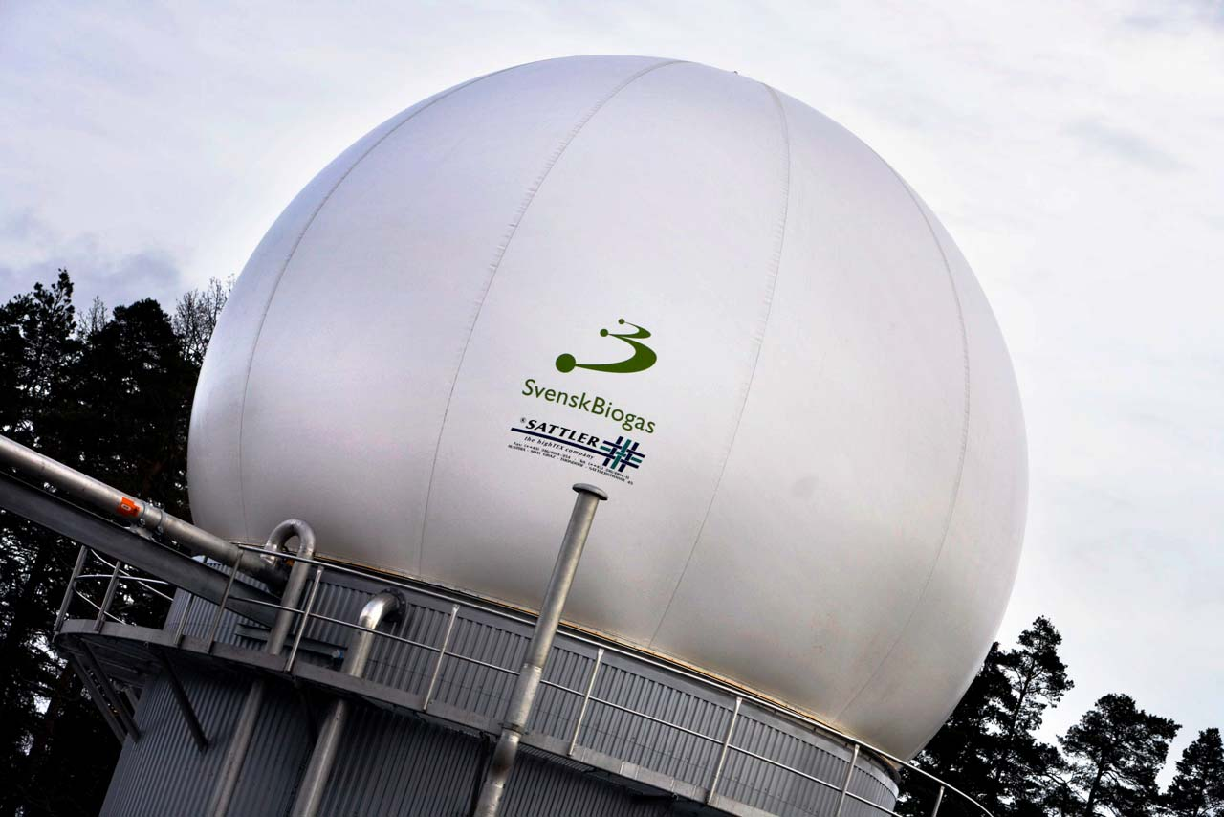
BIOGAS沼气
233 plants (133 waste water treatment plants)
233个沼气工厂（133个建在污水处理厂）
1400 GWh
(734 GWh for vehicles734GWh用作汽车燃料)
Reduced volume of sludge
极大的减少污泥量
In Stockholm: 斯德哥尔摩市有280辆公交车和15000辆汽车用沼气做燃料。
280 buses, 15.000 cars
Notes:
Biogas can be produced from many different types of material. We primarily use waste water sludge, but also organic waste from households, restaurants and slaughter houses.
The material goes through an anaerobic digestion process and turned into Methane + CO2 (33%)
Upgrading to vehicle fuel is done by removing the CO2 in different ways (active carbon / water + high pressure). The result is pure methane (98%), which can be mixed with natural gas. Stockholm has 15.000 biogas cars, most taxis, half of the inner city buses run on biogas.
Rest products (50%) can be used as fertilizer for farming, but many farmers are sceptical due to micro plastics, but also for landfill (road works, mines)

Slide 9
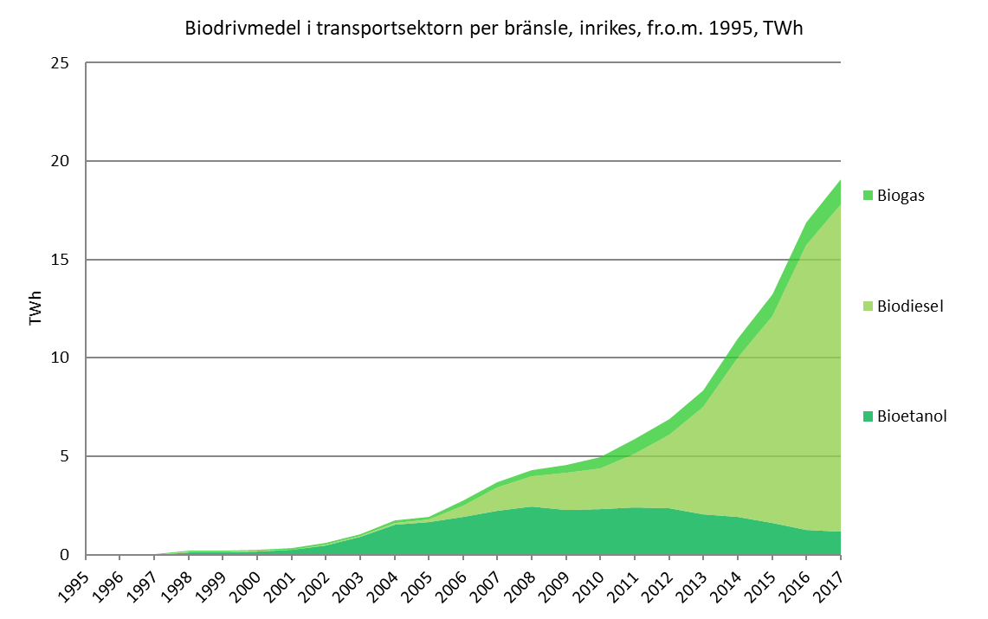
Use of biofuels for transport
(TWh)
Biofuels in the transport sector per fuel, domestic, from 1995, TWh
Biofuels for transport in Sweden has increased since 2001
Renewable fuels reached the 10 percent EU target for 2020 in 2012
生物沼气
生物柴油
生物乙醇
Source: Swedish Energy Agency & Statistics Sweden
Notes:
The use of biofuels for transport in Sweden has increased steadily since 2001. Together with renewable electricity for railroads, renewable fuels had reached the 10 percent EU target for 2020 during 2012, eight years ahead of time.
Source: Swedish Energy Administration
瑞典交通行业从2001年开始大量使用生物燃料，并且用量逐渐增加。早在2012年，瑞典就提前实现了欧盟的2020年目标（可再生能源占交通行业的10%以上），提前8年实现目标。
来源：瑞典能源局。

Slide 10
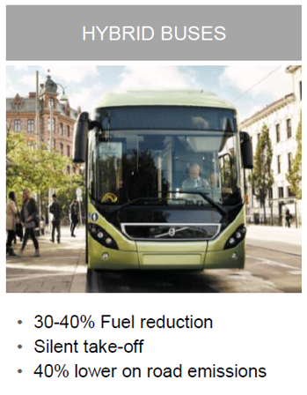

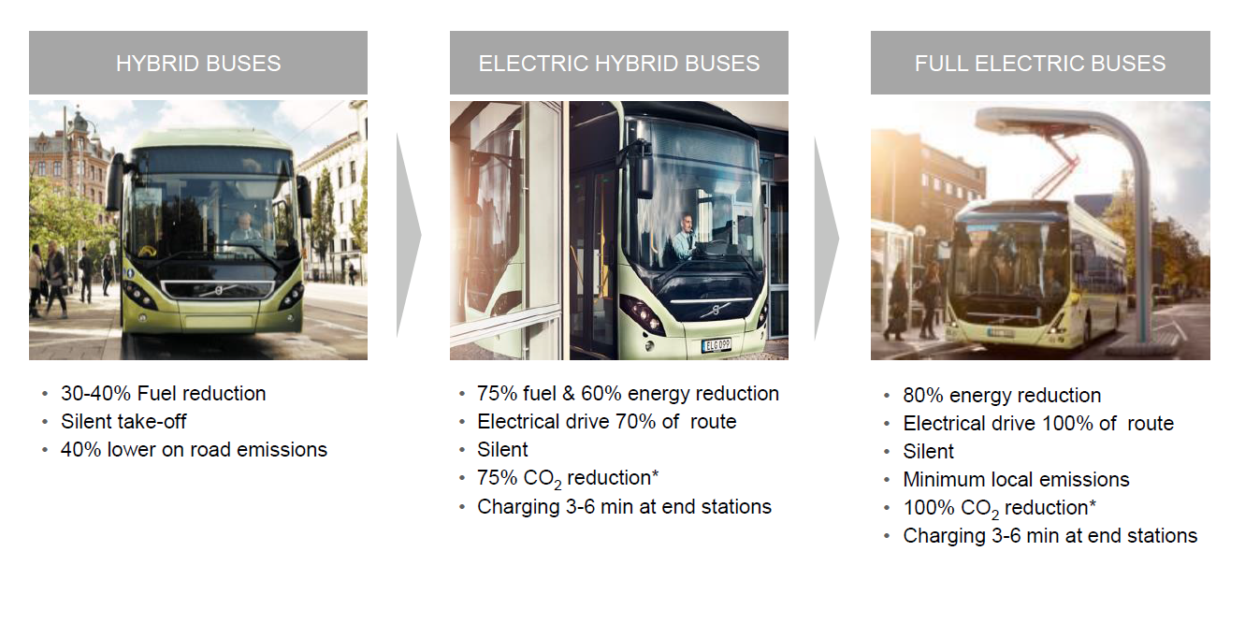
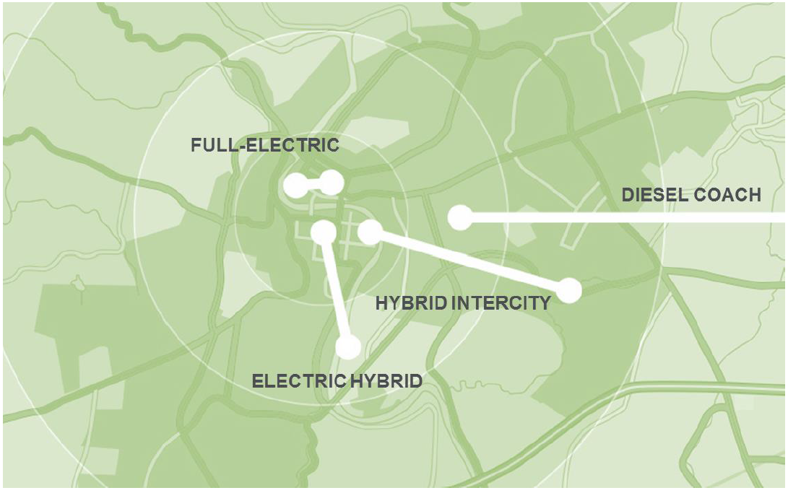

7 electric hybrids
3 fully electric buses

Slide 11
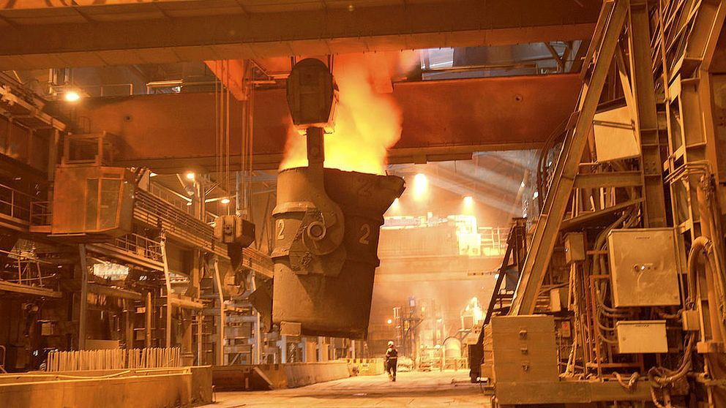
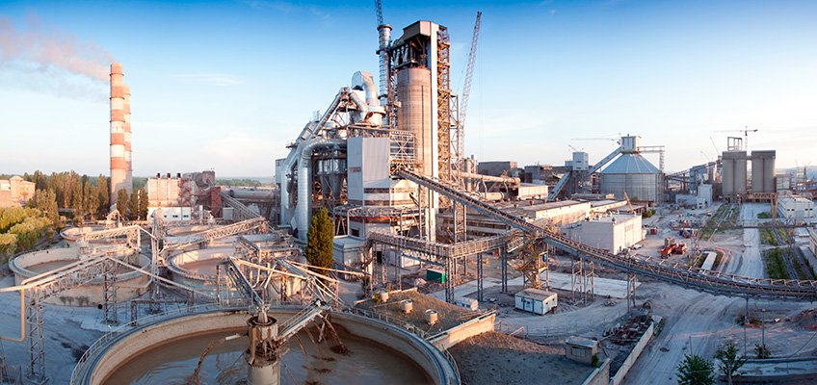
Basic materials are key
Cement and Steel production account for 20% of Sweden’s emissions
Reaching zero emissions in Sweden will require transformative changes in how we produce base materials
The technologies to decarbonize are largely known: CCS, electrification, increased use of biofuels and Hybrit.
Swedish steel- and cement industry have proposed technologies and a time plan for deep decarbonization
Notes:
I already mentioned Steel. It account for 7% of emissions world wide.
In Sweden, cement and Steel production account for 20% of all emissions.
Clearly, these are important elements to build cities and transport infrastructure: For buildings and constructions, cars and rails.
As the energy sector is decarbonizing, basic materials like cement and steel will have an increasingly large share of EU:s emissions.
Disregarding a possible scenario with fossil-free steel if the Hybrit –project will become a success, the technologies to decarbonize are largely known already today: CCS, electrification, increased use of biofuels.
Industry say they are ready and willing to go forward with these technologies, but too little is happening, why is that?
The answer is that there is a lack of incentives for industry.

Slide 12
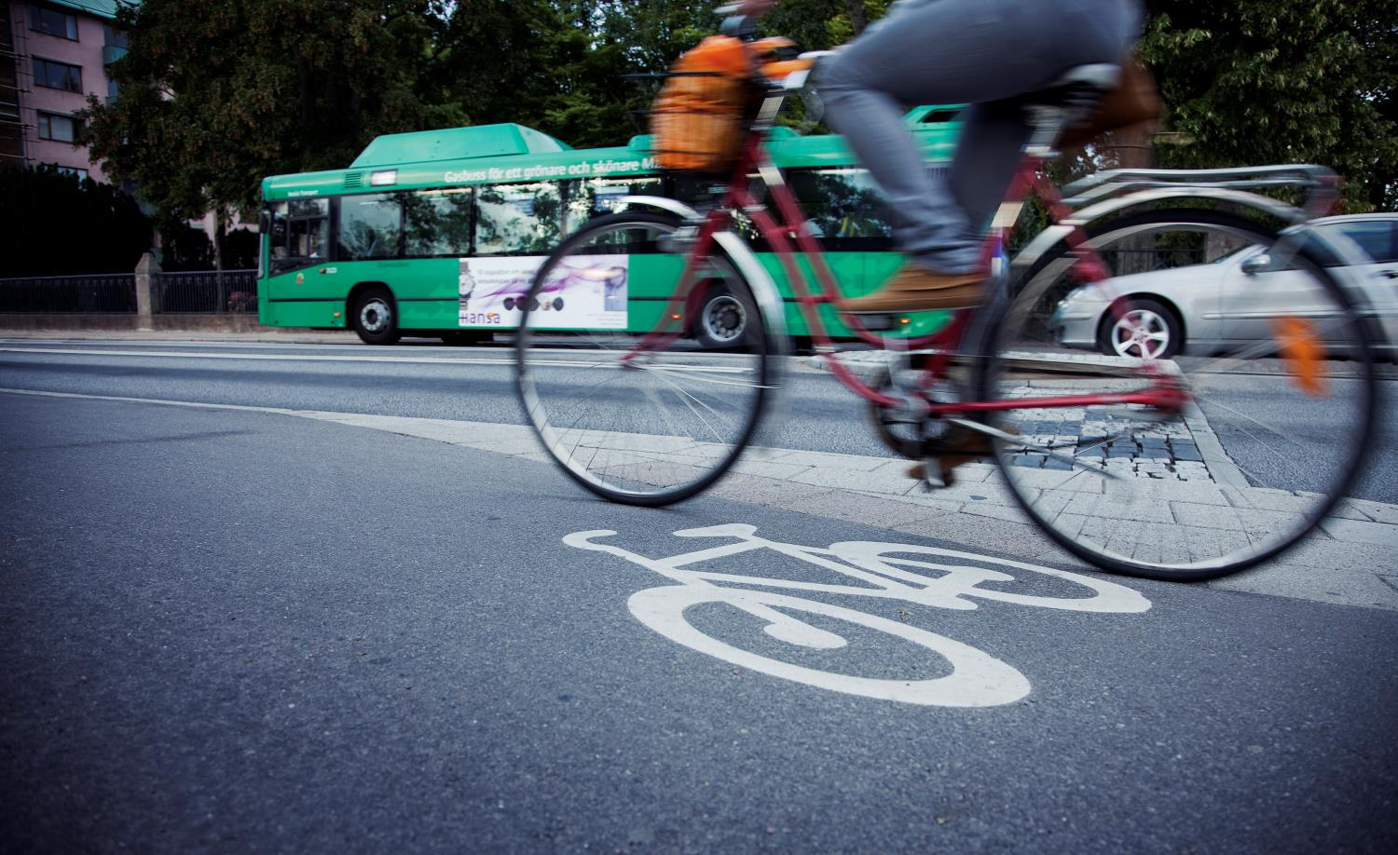
Smart mobility
Notes:
Sticks and carrots
Congestion charges in the main cities: reduce car traffic + fund public transport
Increase use of Public transport (Biogas / Ethanol / Electric buses)
Electric mopeds (25% government discount!)
Car pools
Bike lanes

Slide 14
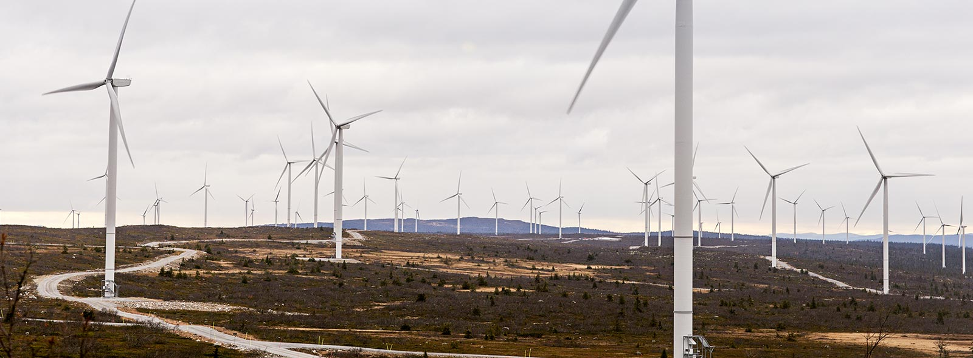

Large scale introduction of wind (and solar PV) requires…
Notes:
One important topic for development and research is how to efficiently integrate large amounts of wind (and solar) power. These are non-dispatchable technologies which in the future electricity system need flexibility on demand side and load following generation which does not emit any CO2.
We use the term “Variation Management Strategies” to describe measures which offer integration possibilities for wind and solar power.
Next slide summarizes the three types of variation management:

Slide 15
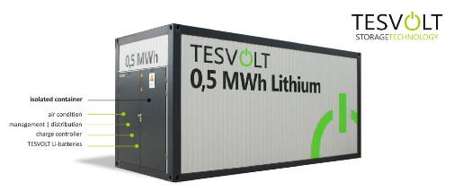
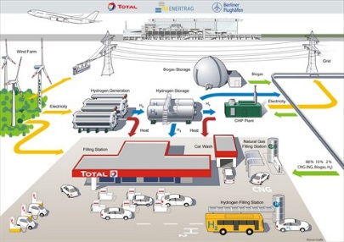
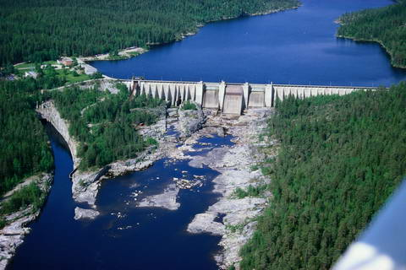
Variation management strategies for maximizing the value of wind and solar PV
Shifting | Absorbing | Complementing
Electricity ⇒ Electricity Reduce curtailment and peak power More even costs on diurnal basis | Electricity ⇒ Fuel and heat Reduce curtailment Fewer low cost events | Fuel ⇒ Electricity Reduce peak power More even costs on yearly basis
Batteries | Power-to-heat | Flexible thermal generation
Load shifting | Electrofuels | Reservoir hydropower
Pumped hydro | Power to gas (hydrogen)
Göransson, L., Johnsson, F. Wind Energy. 2018;1–18.
Notes:
There are three principal types of Variation Management:
Shifting – the shift load in time (demand side management). Charging of electric vehicles (Evs) can offer this service. In the future EVs may even offer discharging electricity to the system (or to the buildings) in a Vehicle to Grid system (V2G).
Using Shifting in a Smart City Strategy will be very helpful to use larger amounts of wind and solar.
Absorbing – to convert electricity to another form of energy carrier which can be stored such as hydrogen.
Sweden is a large producer of Steel, which is a process that produce a terrible amount of CO2. Swedish actors is cooperating in the Hybrit-project to replace the need for carbon with Hydrogen in the steel making process. This will lead to fossil free steel making.
The third type of variation management is Complementing – to introduce flexible dispatchable power generation such as biomass fired combined heat and power plants or biogas fired gas-turbine peak units. In Sweden we also have hydropower with large reservoirs which can act as dispatchable power.
The importance is that efficient integration of renewable electricity requires increased sectoral coupling between electricity, industry, building and transportation sectors, all necessary components in a smart city strategy. All this is studied in the Mistra Carbon Exit program (as well as in other research programs)

Slide 16
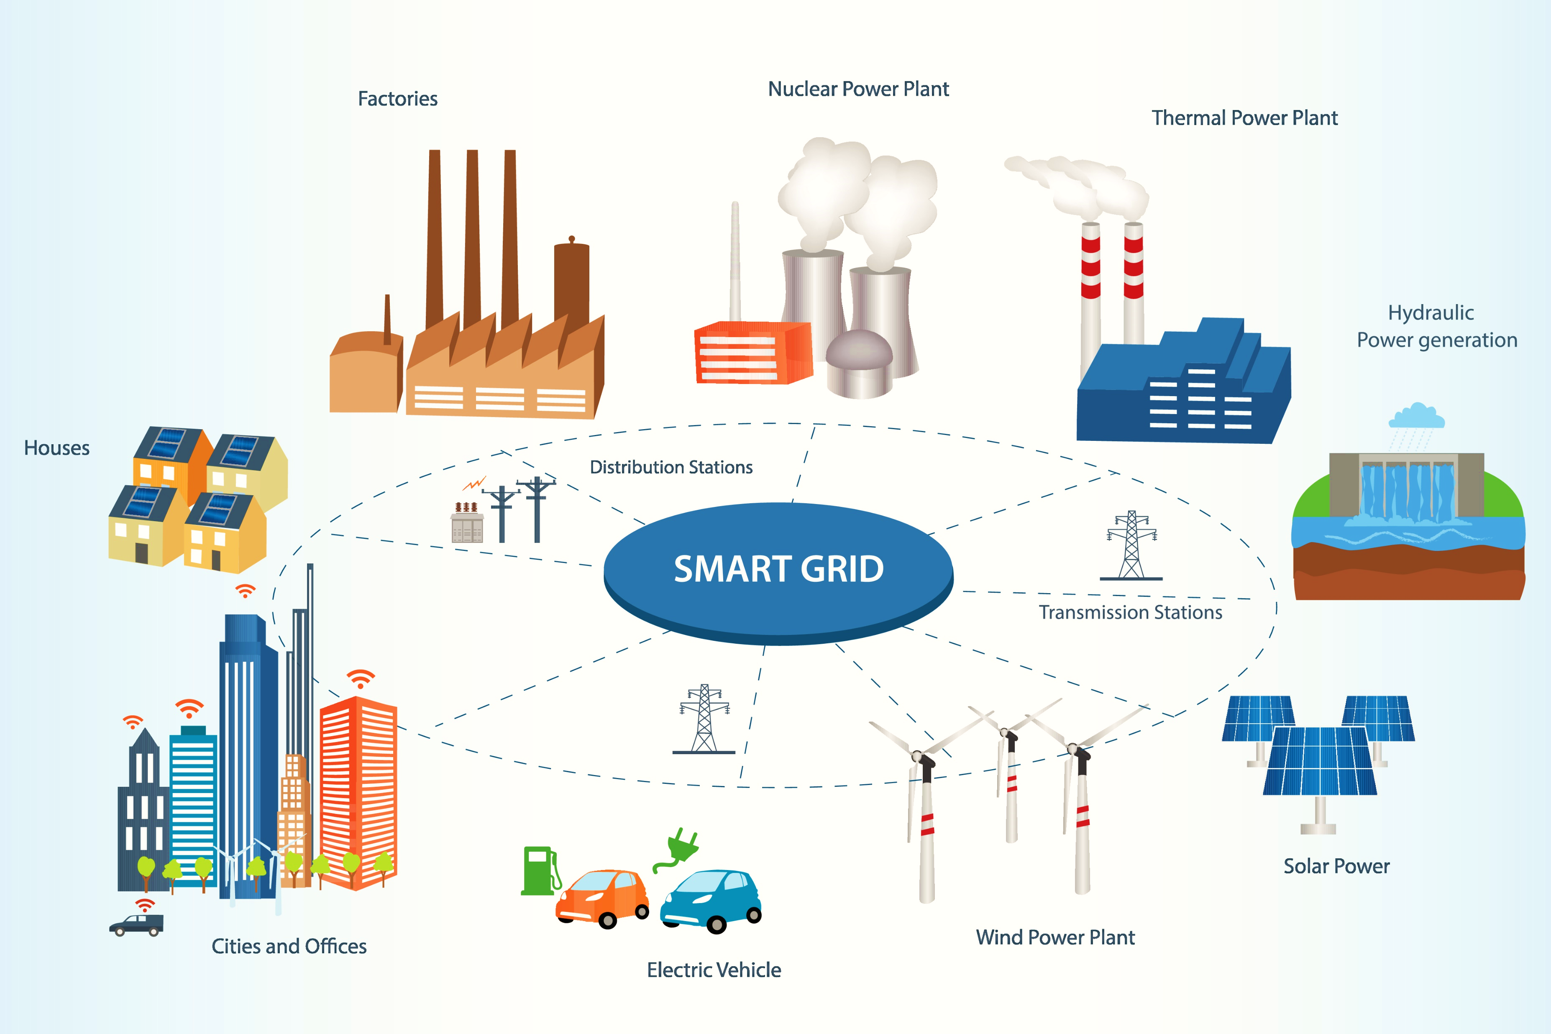
SMART GRIDS
Illustration: Monica Simona Odoroaga
Notes:
The ”smart” in Smart Grids is in the communication between the different elements. This can be used to optimize energy flows, often related to reducing costs at peaks of usage.
Local, individual producers, can sell electricity back to the grid.
Electric cars can be used as storage units for the grid.

Slide 17
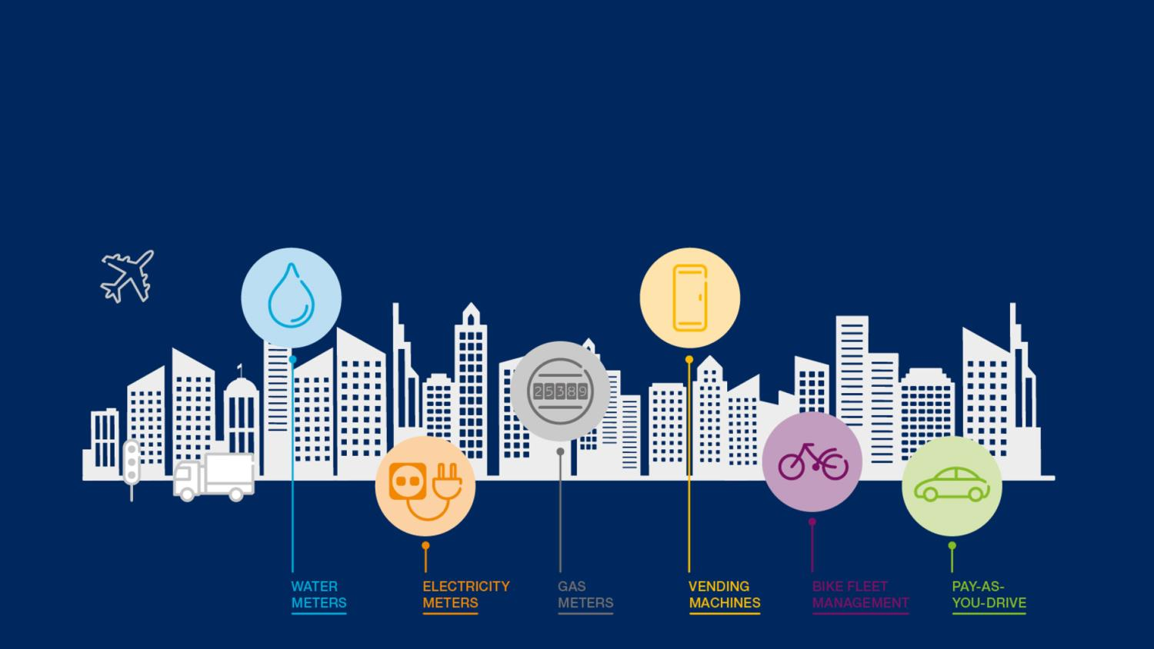
INTERNET OF THINGS
–
Notes:
Internet of Things will be very helpful in order to measure different activities in the city.
Analysing big data from many different sources in a city (water, waste, electricity, transportation etc.) makes it possible to create smart services for citizens, and to optimize resource use etc.
Image: Ericsson

Slide 18
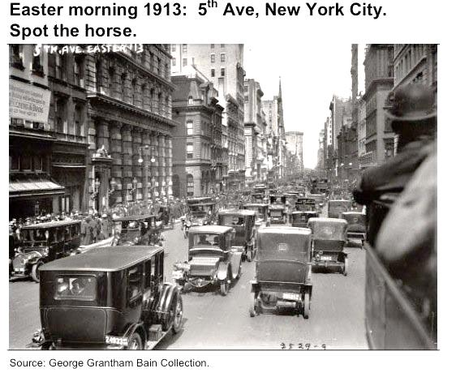
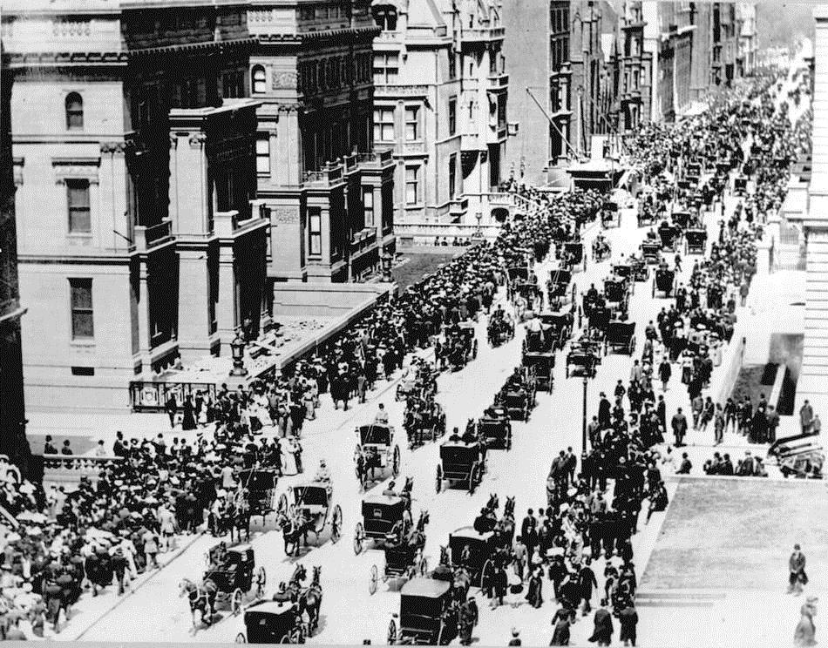
We have seen fast changes before
5th Ave New York City 1900. Spot the car.
Notes:
Vi har sett att vissa förändringar kan gå snabbt.
Tänk hur vi använder telefoner idag jämfört för 10 år sedan.
Mycket är redan på gång. Kostnaderna för sol och vind har minskat dramatiskt och konkurrerar med kol.

Slide 19
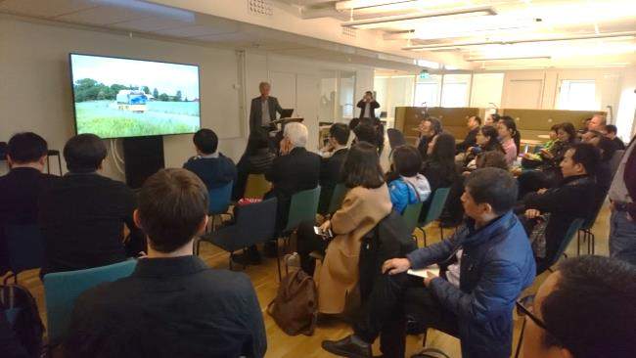
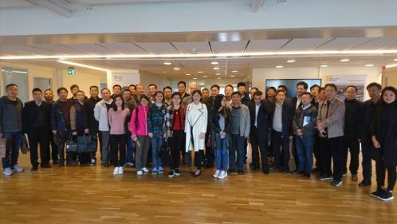
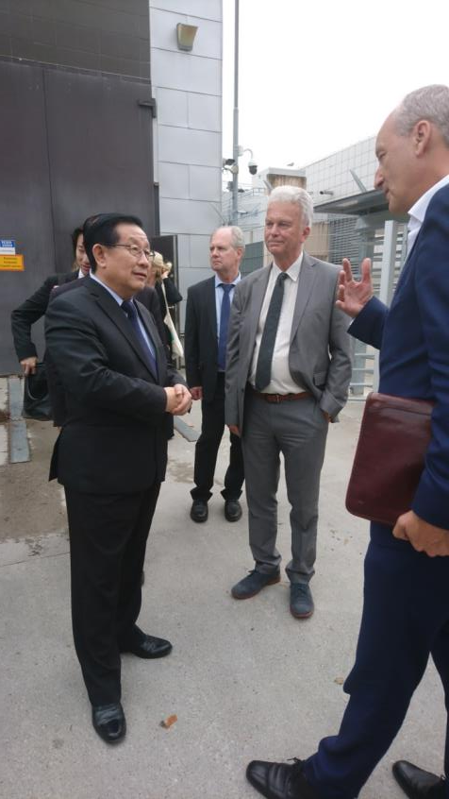
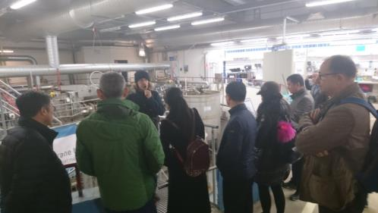
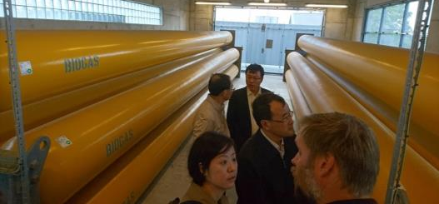
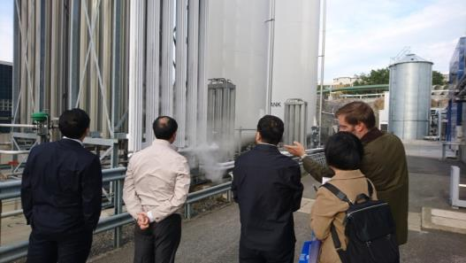
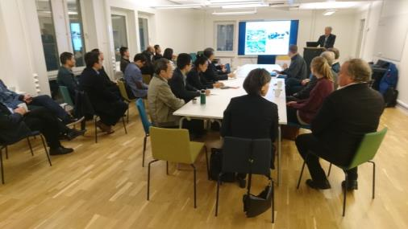
Notes:
From the top left, going down:
China conference in May
Ministry of Water Resources of China, August x2
Minister of Science and Technology, Wan Gang
MWR sthlm water week
SSE CEOs at Sjöstadsverket
Chinese Energy Agency

Slide 20
Peru-Sweden Co-operation
Universidad Nacional de Moquegua (UNAM)
How to produce your own energy in the Campus area?
Pre feasibility study between the University and Smart City SWeden

