Slide 1


Train to Ground broadband communications for urban rail and metros
Sustainable Urban Transport
alfredo.gonzalez_herrero@nokia.com
Transportation Latin America Head of Sales
Lima, December 9th, 2021
1
© 2021 Nokia

Slide 2
Key challenges for urban railway operators
Enabling safe, on-time and connected journeys

Slide 3
Mission-critical broadband network – the integral foundation
Urban rail operators embracing digital transformation
Applications
Safety-critical
CBTC
SCADA
Safety-related
CCTV
Mission-critical voice
Door clearance
PIS/PA
IoT
Non safety related
Public Wi-Fi
Infotainment
Mission-critical broadband communications network

Slide 4

Nokia Train to Ground solution for urban rail
Mission-critical performance
Multi-path connectivity
Flexibility of solution
Modular/supplier/
integration flexibility
Optimized TCO
Service convergence
on a single network
Future proof
5G ready evolution strategy
High availability secure broadband solution
CBTC
CCTV/safety applications
MC-PTT/PTV applications
Passenger entertainment
Maintenance data
Train to Ground solution
Onboard equipment
Trackside equipment
Core
Fleet Network manager
Professional services

Slide 5
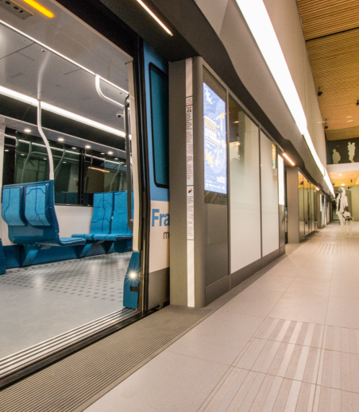



Ultra high 4G bandwidth for fully Automatic Rail Operation
Société du Grand Paris is deploying a Nokia ultra high bandwidth LTE network to support fully automatic rail operations on new metro lines 15,16, and 17
(64 stations and 200 km rails)

Slide 6
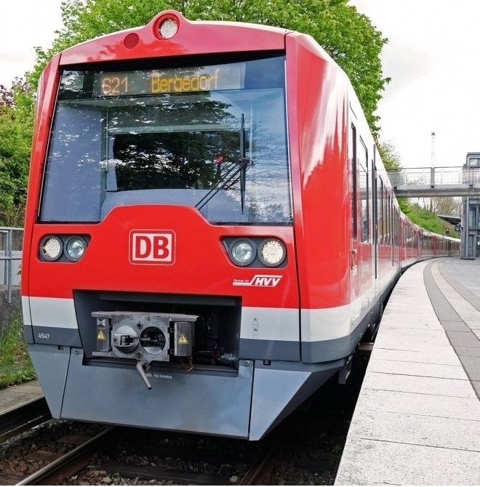
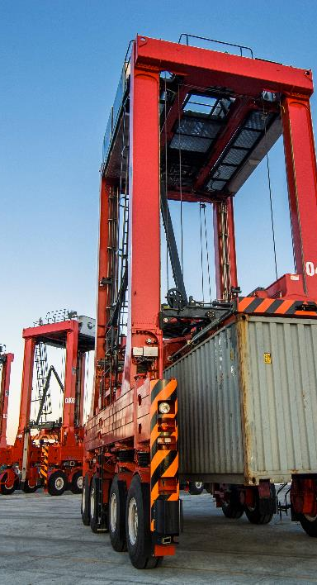

Automatic Train Operations for S-Bahn Hamburg based on 5G
“With the digital S-Bahn we have an intelligent solution for at least 20 percent more capacity without having
to build a new meter of track. That means additional trains, even more climate-friendly travel and more operational stability for our passengers.”
Kay Uwe Arnecke
Managing Director of the Hamburg S-Bahn

Slide 7

Imagine a world with #NoBoundaries
alfredo.gonzalez_herrero@nokia.com
Transportation Latin America Head of Sales

